Slide 1
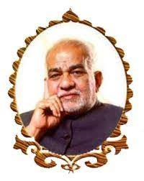

IoT BASED BIDIRECTIONAL VISITOR COUNTER
BVRIT HYDERABAD
College of Engineering for Women
Department Of Information Technology
Team – 5
G Esha(19WH1A1221)
P Preethi(19WH1A1231)
M Harshini(19WH1A1233)
I Harshitha(19WH1A1257)
Under the Guidance of
Guide Name : Mr. Ch. Anil Kumar
Designation : Assistant Professor

Slide 2
Summary of Stage I
Stage 1 concludes counting no of visitors incoming and outgoing and display the count on LCD.
We have used two IR sensors and Arduino as microprocessor

Slide 3
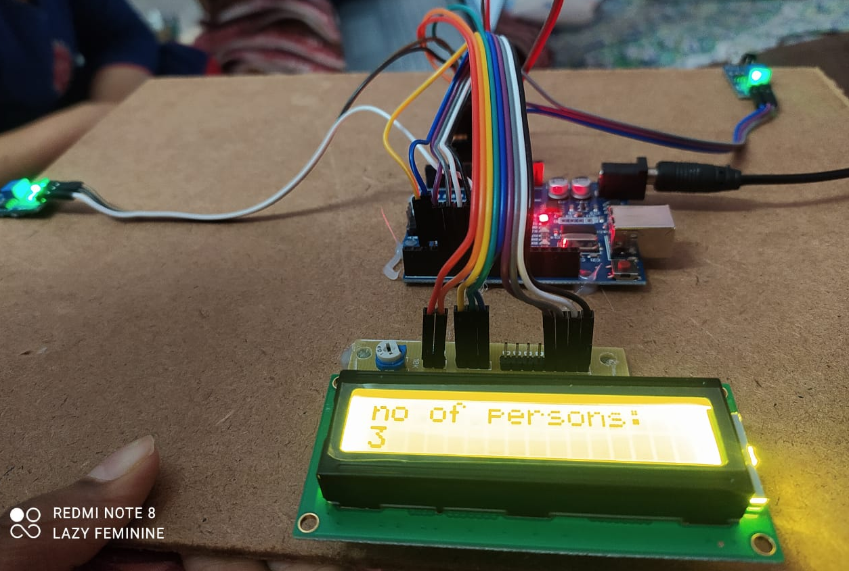
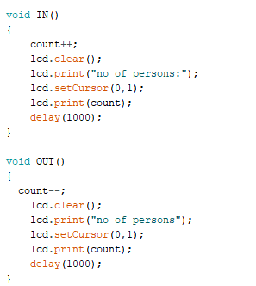
Implementation of Experimental Design
Visitor Counter

Slide 4
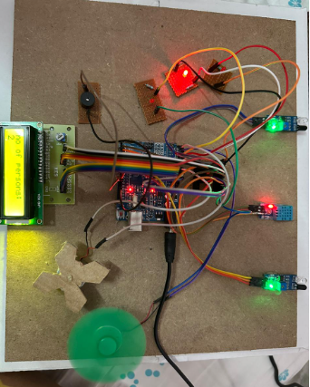
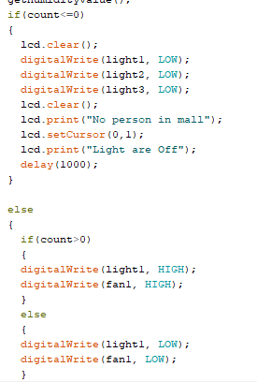
Implementation of Experimental Design
Device Automation

Slide 5
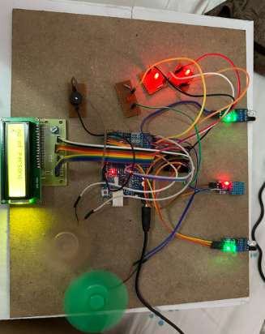
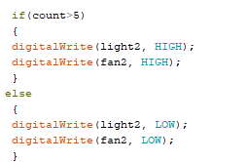
Implementation of Experimental Design

Slide 6
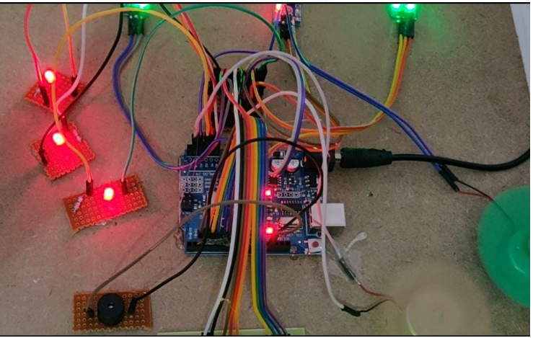
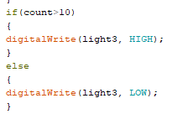
Implementation of Experimental Design

Slide 7
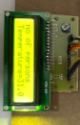
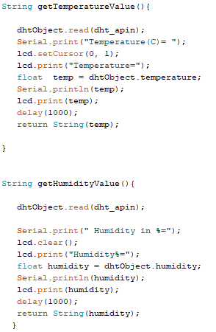
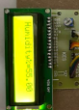
Implementation of Experimental Design
Environment Monitoring

Slide 8
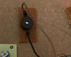
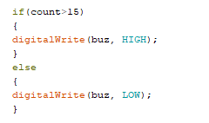
Implementation of Experimental Design
Buzzer

Slide 9
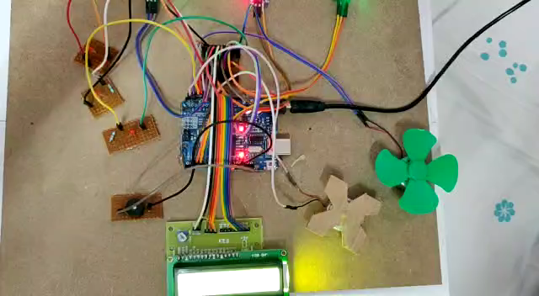
Execution Video

Slide 10
Analysis of Result
Count of incoming and outgoing visitors is completed.
Device automation is completed.
Environment monitoring is completed.
Adding buzzer is completed
Publication work is in progress abstract introduction literature survey and components is done.

Slide 11
Conclusion & Future Scope
This project demonstrates the potential of IoT technology to improve our daily lives by increasing efficiency and reducing energy consumption.
Real life implementation by adding camera to identify people that are incoming and outgoing rather than IR sensor for better accuracy and results.

